Slide 1

LU & Cholesky Decomposition
A high-performance mathematical guide to matrix split principles and symmetric positive-definite systems.

Slide 2
Part I: LU Decomposition
The standard for general square matrix factorization

Slide 3


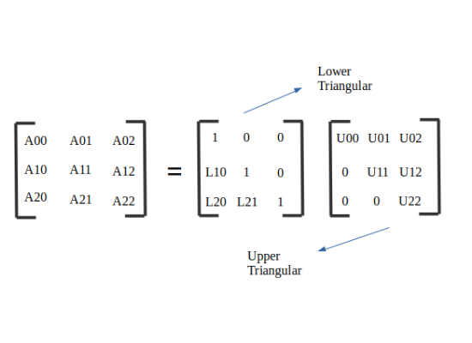
The Split Principle
Fundamental Factorization
The Components
LU decomposition breaks down a square matrix into the product of two triangular matrices: a Lower (L) and an Upper (U).
L (Lower): Lower-triangular matrix, often with 1s along the diagonal in Doolittle's method.
U (Upper): Upper-triangular matrix containing the result of Gaussian elimination.

Slide 4

Solving Linear Systems
Instead of expensive matrix inversion, a linear system Ax = b is resolved elegantly using two triangular substitutions:
Solve Ly = b for y via forward substitution.
Solve Ux = y for x via backward substitution.
This approach is significantly more stable and computationally efficient for multiple b vectors.

Slide 5
Numerical Example (3x3)
Row | Target Matrix A | Lower L (Unit Diag) | Upper U
Row 1 | [1, 2, 4] | [1, 0, 0] | [1, 2, 4]
Row 2 | [3, 8, 14] | [3, 1, 0] | [0, 2, 2]
Row 3 | [2, 6, 13] | [2, 1, 1] | [0, 0, 3]

Slide 6
Part II: Cholesky Decomposition
Optimized for Symmetric Positive-Definite (SPD) Matrices

Slide 7
Efficiency Gains
50%
Fewer Operations
Cholesky requires exactly half the floating-point operations (FLOPs) of general LU decomposition by exploiting matrix symmetry.
It also requires half the memory, as only the single factor L needs to be stored.

Slide 8
Strict Structural Preconditions
Symmetry: The matrix must be identical to its transpose. Off-diagonal elements must match perfectly.
Positive-Definiteness: For any non-zero vector x, the quadratic form xTAx must be strictly positive.
Real Values: All eigenvalues must be strictly positive to avoid imaginary components during square root calculations.
Non-Singularity: The matrix must be full rank. Zero pivots lead to immediate computational failure.

Slide 9
Mathematical Relationship
When matrix A is symmetric, LU simplifies to LDU. Distributing diagonal scaling yields the Cholesky factor.
This creates a single lower triangular factor multiplied by its own transpose, acting as a "square root" for the matrix.

Slide 10




Cholesky Calculation Flow
Diagonal Elements
Off-Diagonal Elements
Calculated using square roots of residuals:
Calculated by dividing the residual by the current pivot:

